Slide 1
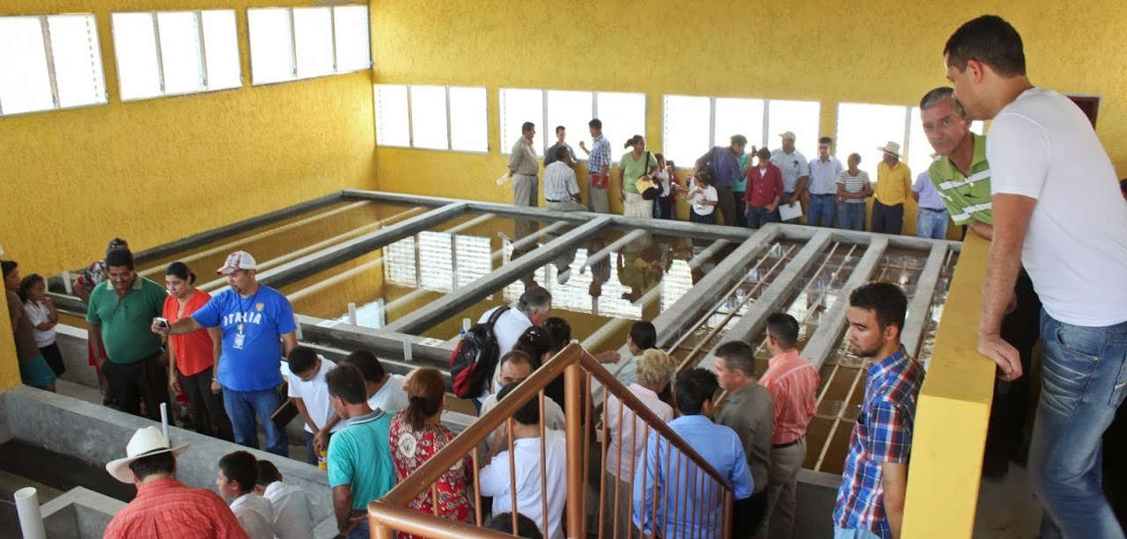
An Elegant Solution for Safe Water on Tap
Monroe Weber-Shirk
Notes:
Add intro to each unit process to help students think about projects

Slide 2
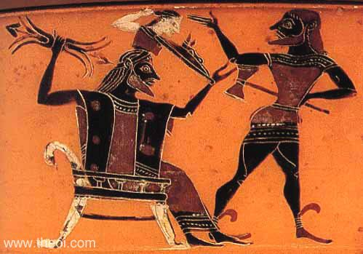


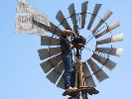
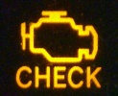
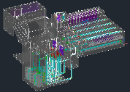
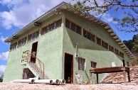
Overview
How to Innovate and Design
The AguaClara Consortium
High-tech and Elegance
Pride of ownership
AguaClara technologies and plants
Philosophy and Reflections
Ctrl + click the pictures to go each section!

Slide 3



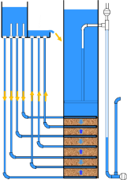
AguaClara Technologies
Chemical dosing
Flocculator
Floc Blanket
Sedimentation
Filtration
Conclusions

Slide 4



Stages of particle removal
Coagulation
Flocculation
Floc Blanket
Sedimentation
Filtration
Nanoparticle deposition
Collisions
Gravity!
Notes:
Here are the five stages of colloid or particle removal in hydraulic drinking water treatment plants. The first stage, coagulation, involves the addition of a chemical coagulant to destabilize a suspension of particles. The coagulant precipitates and attaches to the particle surface. Then in flocculation, velocity gradients in the water cause the particles (now coated in precipitated coagulant) to collide and stick to one another forming aggregates. In floc blankets there are many more opportunities for collisions. In sedimentation, fluid flow is very slow and the aggregates settle to the bottom of the tank. Filtration is often used to remove any remaining particles but is not included in the bench-scale setup.

Slide 5
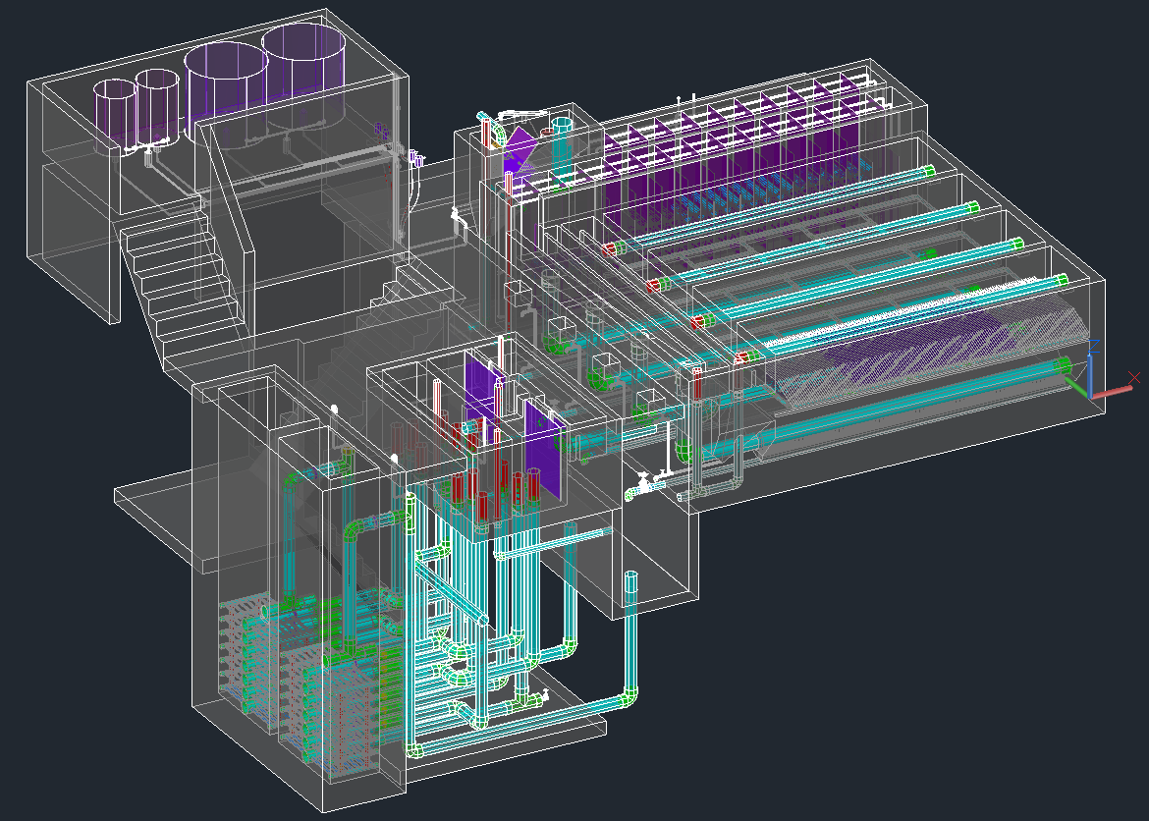
Chemical Dosing
Entrance Tank
Chemical Stock Tanks
Flocculator
Sedimentation
Open Stacked Rapid Sand (OStaRS) Filter
Drain Channel

Slide 6
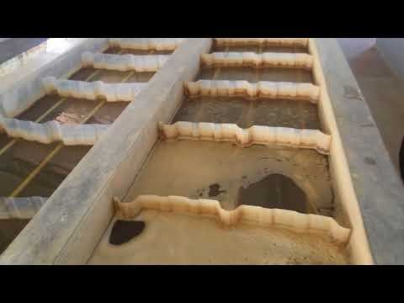
Tour of an AguaClara plant

Slide 7
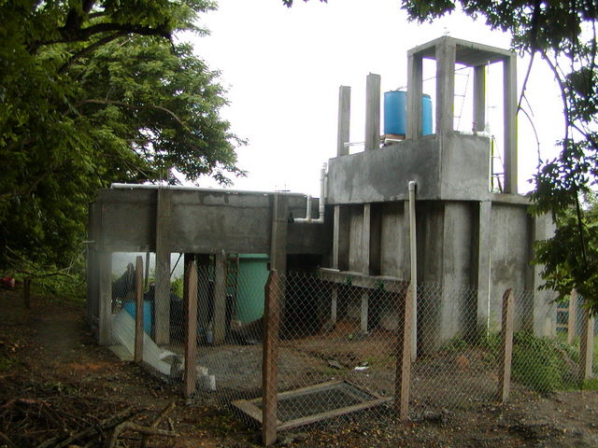
Plant zero
Entrance Tank
Elevated flocculator
Sedimentation Tank

Slide 8
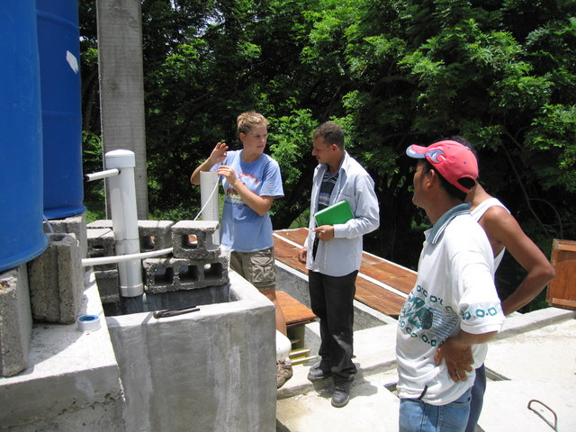

Slide 9
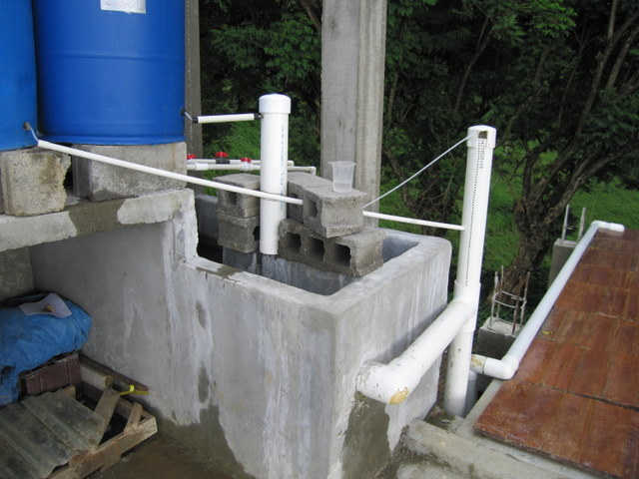
What do you see?
Why did this happen?

Slide 10
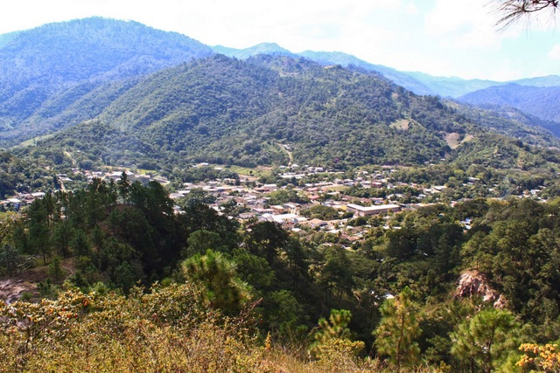
San Nicolas

Slide 11
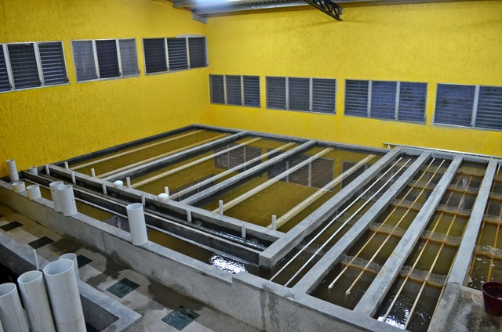

Slide 12
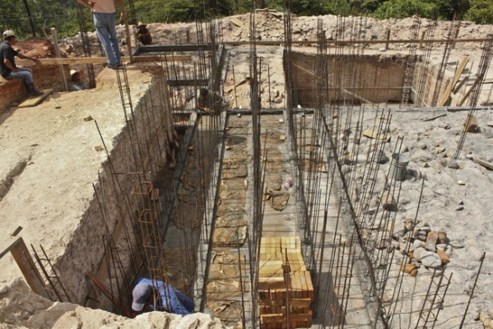
Flocculator Channels

Slide 13
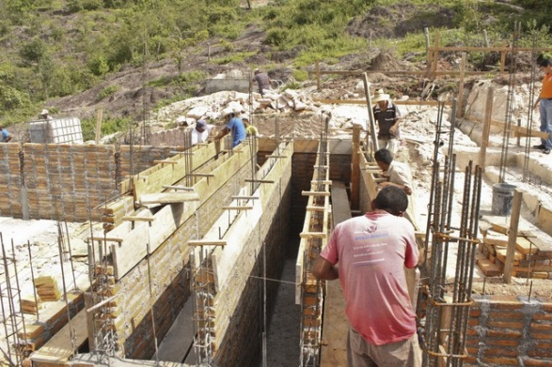

Slide 14
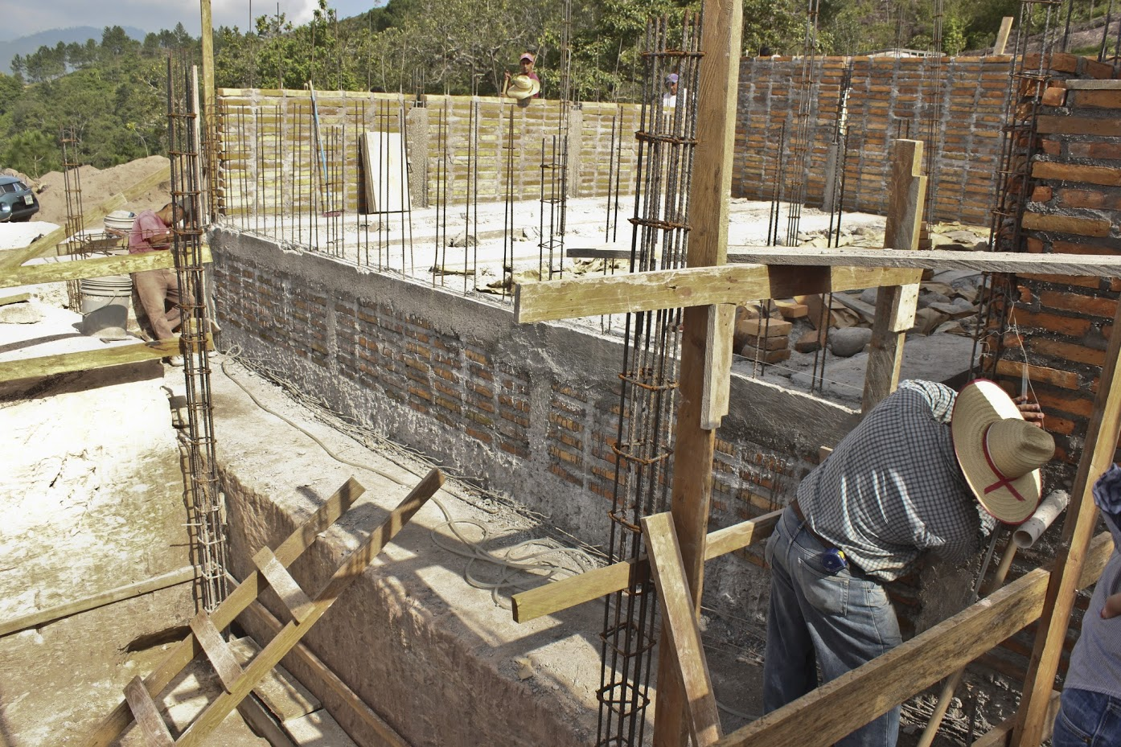
What do you see?

Slide 15
What is the difference between laser level and water level?
Suppose I am building a really big structure…

Slide 16
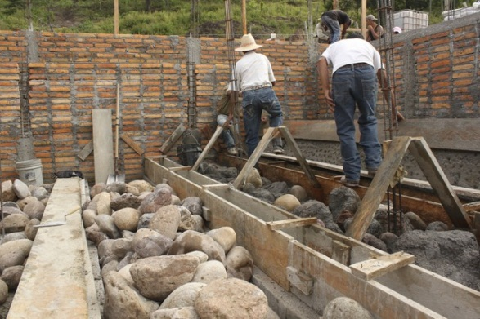

Slide 17
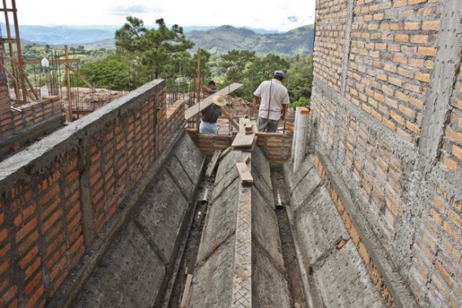

Slide 18
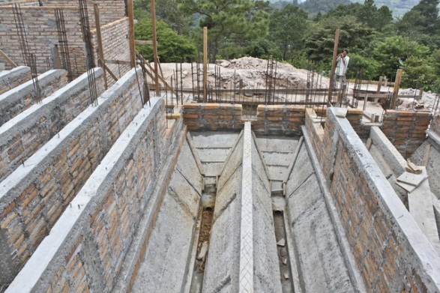

Slide 19
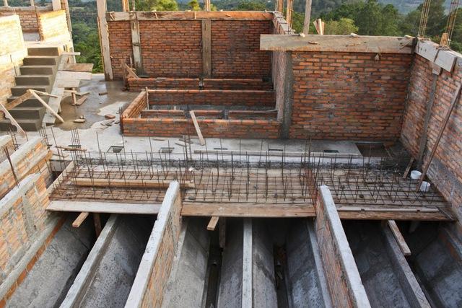

Slide 20
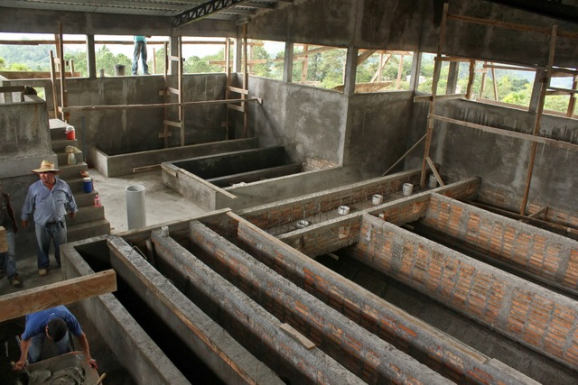
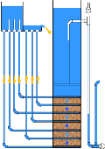


Slide 21
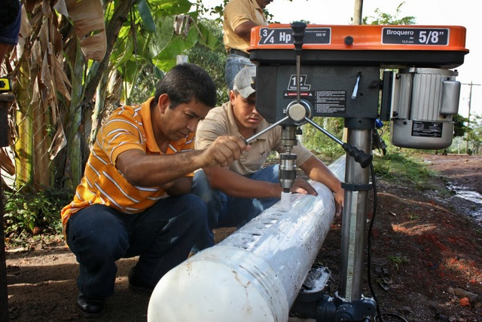

Slide 22
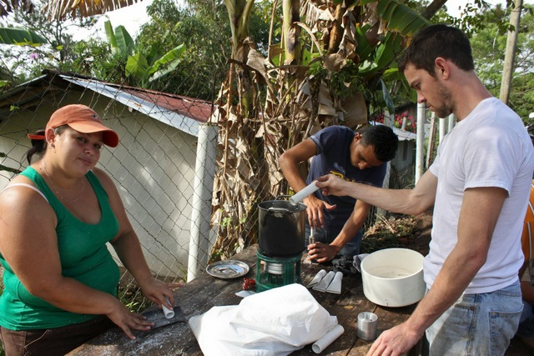

Slide 23
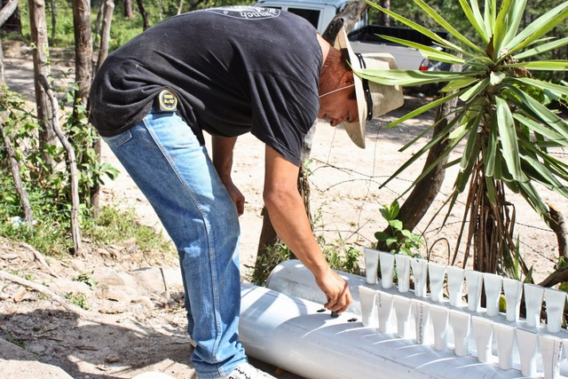

Slide 24
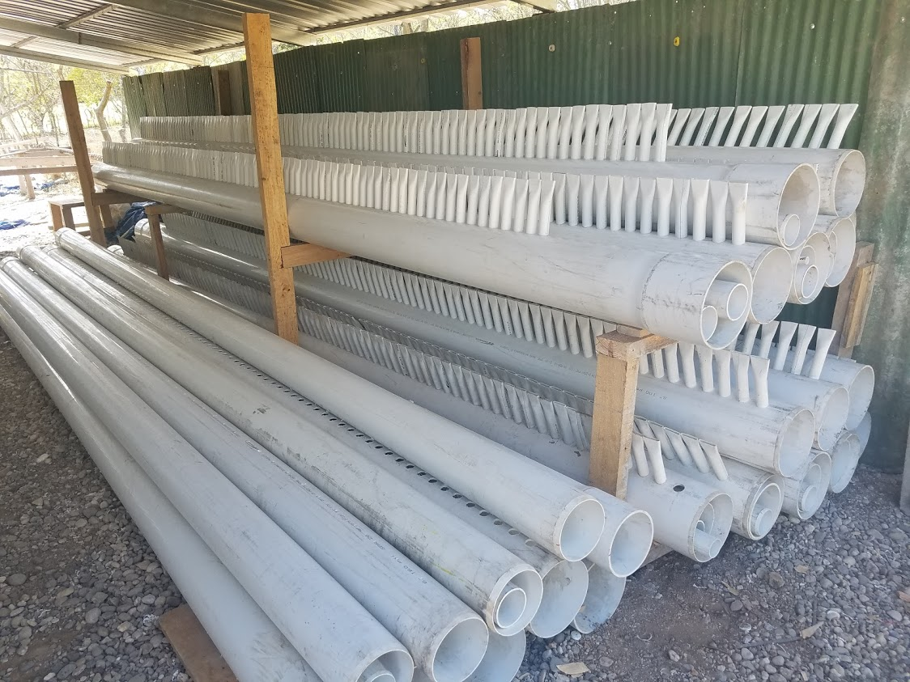

Slide 25
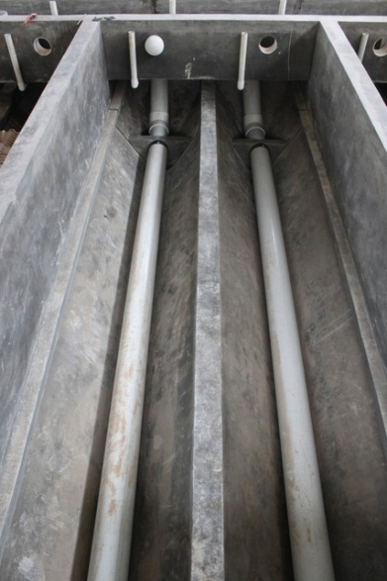

Slide 26
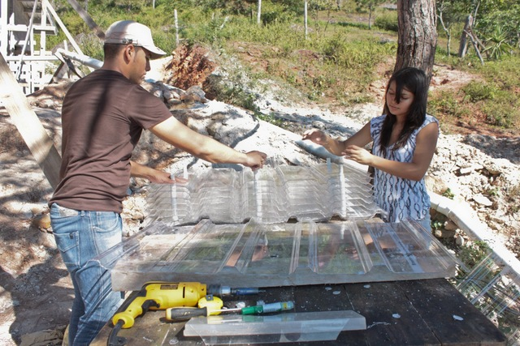

Slide 27
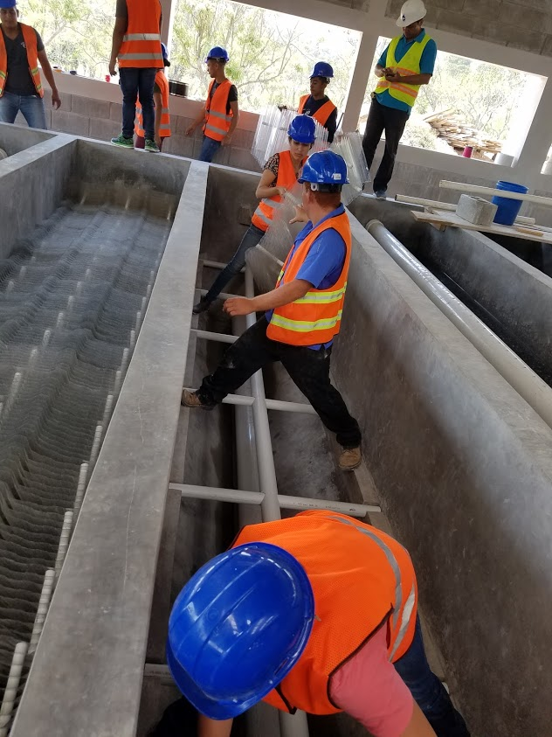

Slide 28
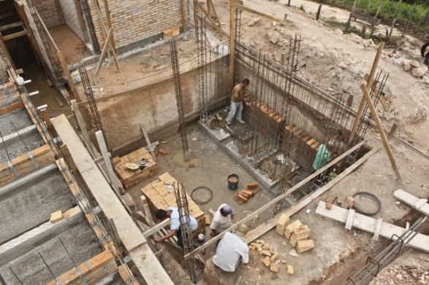

Slide 29
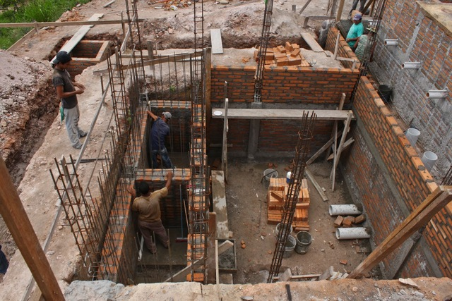
Sludge drains!
Sed tank drains!
Backwash water!
2 Filters
Filter Pipe Gallary

Slide 30
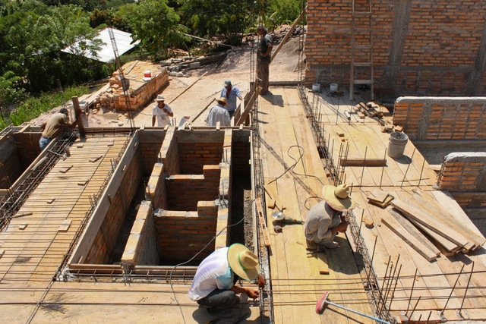
Sed tanks
Sed tank
Inlet and outlet channels
Filter
Filter Inlet
Filter Outlet

Slide 31
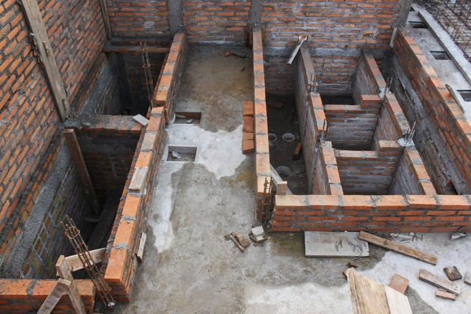
Filter Inlet
Filter Outlet
Filters

Slide 32
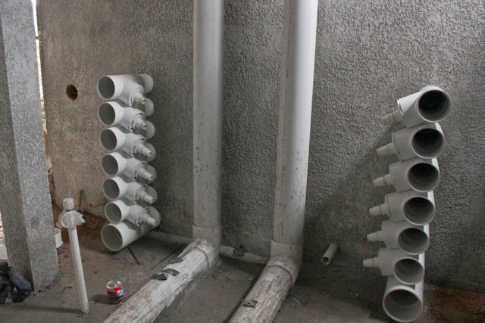
Backwash siphon
Backwash siphon

Slide 33


Slide 34


Slide 36
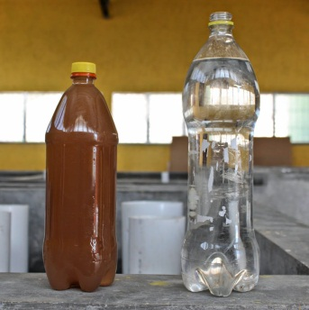
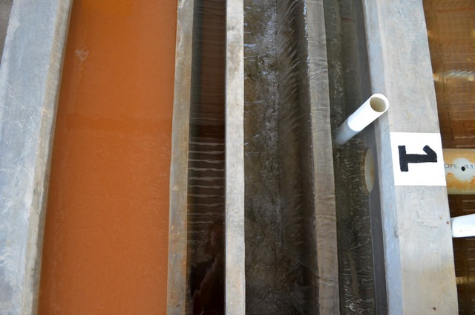
Flocculated water
entering the sedimentation tank
Settled water

Slide 37
Stages of particle removal
Coagulation
Flocculation
Floc Blanket
Sedimentation
Filtration
Nanoparticle deposition
Collisions
Gravity!
Notes:
Here are the five stages of colloid or particle removal in hydraulic drinking water treatment plants. The first stage, coagulation, involves the addition of a chemical coagulant to destabilize a suspension of particles. The coagulant precipitates and attaches to the particle surface. Then in flocculation, velocity gradients in the water cause the particles (now coated in precipitated coagulant) to collide and stick to one another forming aggregates. In floc blankets there are many more opportunities for collisions. In sedimentation, fluid flow is very slow and the aggregates settle to the bottom of the tank. Filtration is often used to remove any remaining particles but is not included in the bench-scale setup.

